Slide 1
Tools for Data Science
17/04/2024

Slide 2
Course Overview
To be successful in Data Science, you need to be skilled at using tools that Data Science professionals employ as part of their jobs. This course teaches you about the popular tools in Data Science and how to use them.
You will become familiar with the Data Scientist’s tool kit which includes Libraries & Packages, Data Sets, Machine Learning Models, Kernels, as well as the various Open source, commercial, Big Data and Cloud-based tools.

Slide 3
Benefits of Enrolling in a Course:
Describe the Data Scientist’s tool kit which includes Libraries & Packages, Data sets, Machine learning models, and Big Data tools.
Utilize languages commonly used by data scientists like Python, R, and SQL
Demonstrate working knowledge of tools such as Jupiter notebooks and RStudio and utilize their various features.
Create and manage source code for data science using Git repositories and GitHub.

Slide 4

Session Content
Overview of Data Science Tools
Languages of Data Science
Packages, APIs, Database & Models
Jupyter Notebooks and Jupyter lab
RStudio & GitHub
IBM Watson Studio

Slide 5
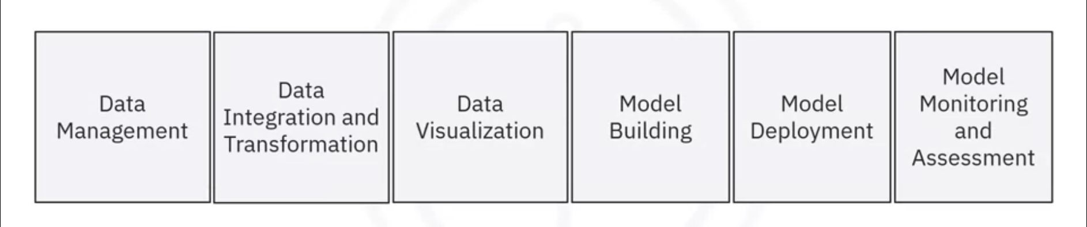
Overview of Data Science Tools
Categories of Data Science Tools
Open-Source Tools for Data Science
Commercial Tools for Data Science
Cloud Based Tools for Data Science

Slide 6
Languages of Data Science
Introduction to Python
Introduction to R Language
Introduction to SQL
Other Languages for Data Science
'

Slide 7
Packages, APIs, Database & Models
Libraries for Data Science
Application Programming Interfaces (APIs)
Data Sets - Powering Data Science
Sharing Enterprise Data - Data Asset Exchange
Machine Learning Models – Learning from Models to Make Predictions
'

Slide 8
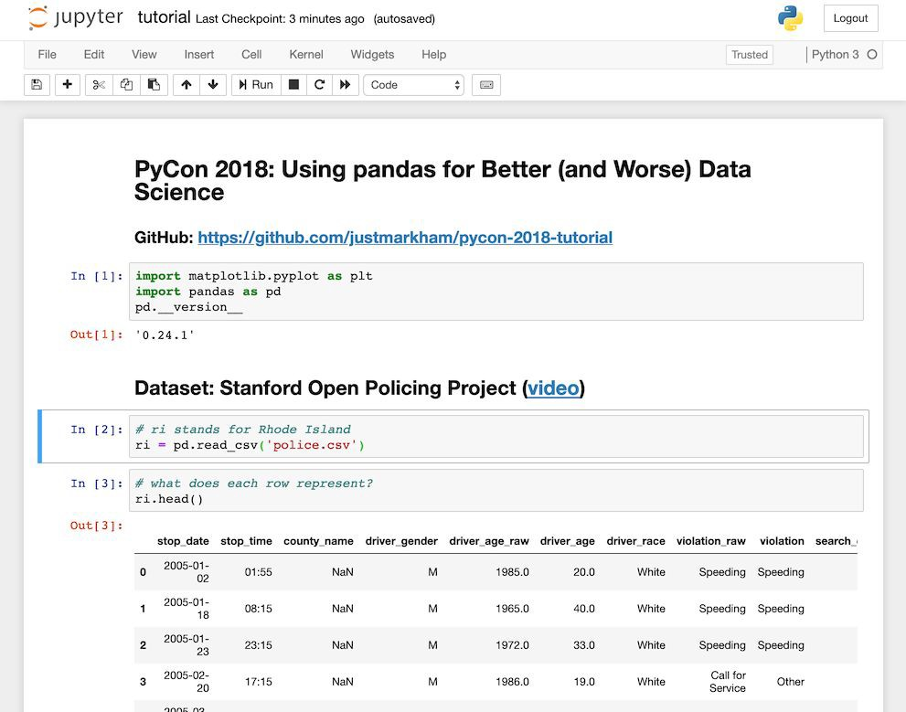
Jupyter Notebooks and Jupyter lab
Introduction to Jupyter Notebooks
Getting Started with Jupyter
Jupyter Kernels
Jupyter Architecture
'

Slide 9
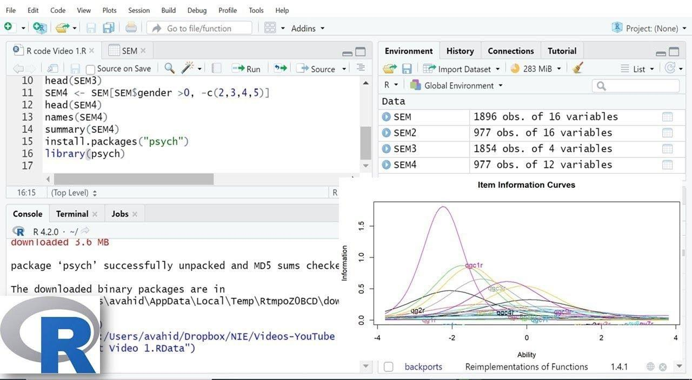
RStudio & Github
Introduction to R and RStudio
Plotting in RStudio
Overview of Git/GitHub
Introduction to GitHub
GitHub Repositories
'

Slide 10
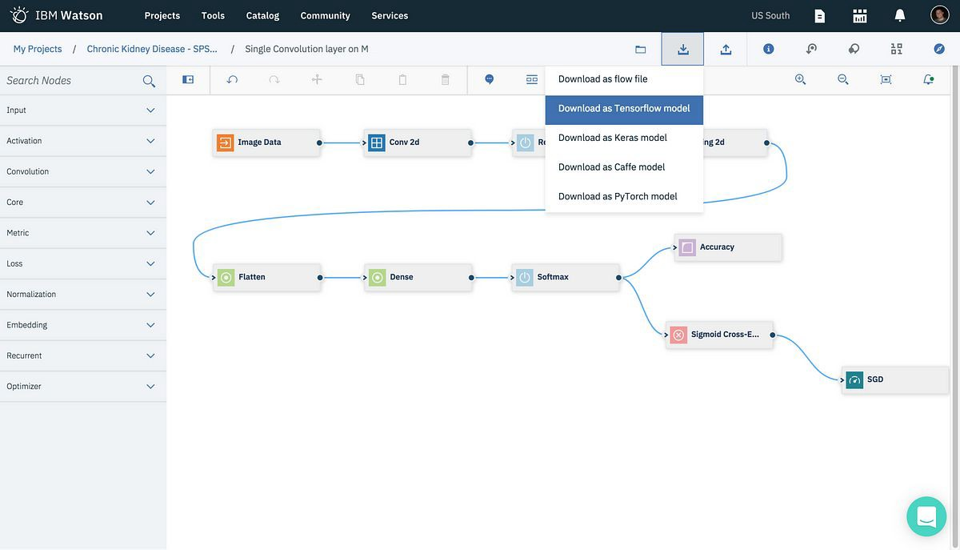
IBM Watson Studio
Introduction to Watson Studio
Jupyter Notebooks in Watson Studio
Linking GitHub to Watson Studio
'

Slide 11
Q&A
Questions and answers

Slide 12
Thanks

